Slide 1


Kenrick Saputra Tedja
27-06-2023

Slide 2

Outline
Executive Summary
Introduction
Methodology
Results
Conclusion
Appendix

Slide 3
Executive Summary
Methodologies
The data is collected using web scraping and SpaceX API utilizing Python to perform Exploratory Data Analysis including data wrangling, data visualization, making an interactive visual dashboard, and performing a machine learning process to predict the landing outcome
Result
Public sources could be utilized to collect data for analysis and with EDA, the insight of the best feature correlated to the landing outcome is determined and the machine learning prediction shows the best model to use for predicting the landing outcome

Slide 4
Introduction
The objective of this project is to determine the cost per launch from SpaceX for Space Y to find insight to compete with SpaceX
The outcome of this project is to estimate the total cost of each launch based on the successful landing of the first stage

Slide 5

Section 1

Slide 6
Methodology
Executive Summary
Data collection methodology:
Data was obtained from SpaceX API and List of Falcon 9 and Falcon Heavy launches
Perform data wrangling
Landing Outcome feature created based on the Outcome feature after summarizing data
Perform exploratory data analysis (EDA) using visualization and SQL
Perform interactive visual analytics using Folium and Plotly Dash
Perform predictive analysis using classification models
The dataset was normalized and divided into training and test datasets and evaluated using four classification model

Slide 7
Data Collection
First data comes from SpaceX API
Second data web scraped from List of Falcon 9 and Falcon Heavy launches

Slide 8
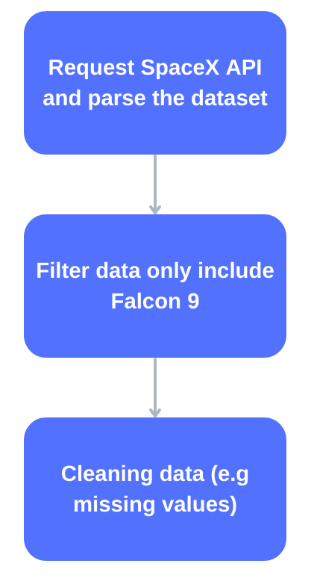
Data Collection – SpaceX API
SpaceX API offers public data and requested using “request” package from Python. The data was used according to the flowchart
The code for the following process is presented through this link (Data Collection)

Slide 9
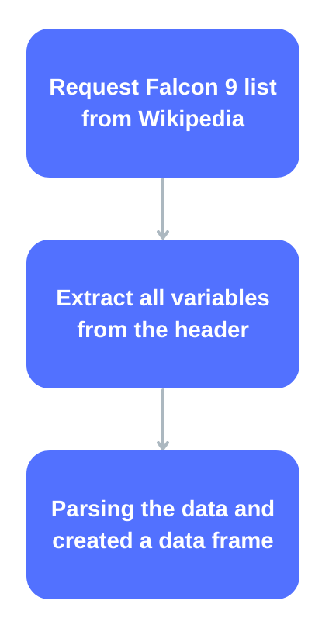
Data Collection - Scraping
The list of Falcon 9 launches was requested using JSON from Wikipedia
The code for the following process is presented through this link (Web Scraping)

Slide 10
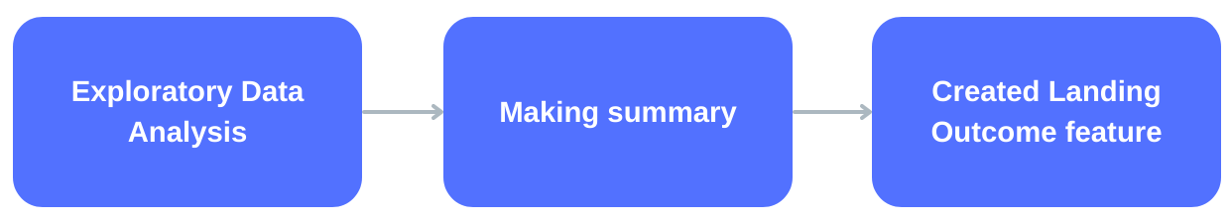
Data Wrangling
Exploratory Data Analysis conducted toward the dataset using data visualization and SQL
The summaries of the dataset including the launches and outcomes with correlation with each feature made. Then, the Landing Outcome feature is created
The code for the following process is presented through this link (Data Wrangling)

Slide 11
EDA with Data Visualization
Scatterplot and Barplot were utilized to see the correlation between each features
The code for the following process is presented through this link (Data Visualization)

Slide 12
EDA with SQL
Using SQL, these queries were perfomed:
Display the names of the unique launch sites in the space mission
Display 5 records where launch sites begin with the string 'CCA'
Display the total payload mass carried by boosters launched by NASA (CRS)
Display average payload mass carried by booster version F9 v1.1
List the date when the first succesful landing outcome in ground pad was achieved
List the names of the boosters which have success in drone ship and have payload mass greater than 4000 but less than 6000
List the total number of successful and failure mission outcomes
List the names of the booster_versions which have carried the maximum payload mass
List the records which will display the month names, failure landing_outcomes in drone ship ,booster versions, launch_site for the months in year 2015
Rank the count of successful landing_outcomes between the date 04-06-2010 and 20-03-2017 in descending order
The code for the following process is presented through this link (EDA with SQL)

Slide 13
Build an Interactive Map with Folium
Markers, circles, lines, and markers cluster were made using Folium
These items were used to highlight points and cluster similar points also measure the distance between two coordinates
The code for the following process is presented through this link (Folium Analysis)

Slide 14
Build a Dashboard with Plotly Dash
Using Plotly Dash, pie chart and scatter plot were made
The chart and plot were utilized to see the percentage of launches and correlation between payload and launch sites
The code for the following process is presented through this link (Plotly Dashboard)

Slide 15
Predictive Analysis (Classification)
The prediction was conducted using four classification models including Logistic Regression, SVM, Decision Tree, and KNN
In this process, the data is prepared and normalized then tested using the classification model to see which model perform the best
The code for the following process is presented through this link (Predictive Analysis)

Slide 16
Results
Exploratory data analysis results
SpaceX uses four different launch sites: CCAFS LC-40, CCAFS SLC-40, KSC LC-39A. VAFB SLC-4E
The average payload for Falcon 9 v1.1 is 2928.4
First landing outcome comes at 2018
Almost every launch was successful

Slide 17
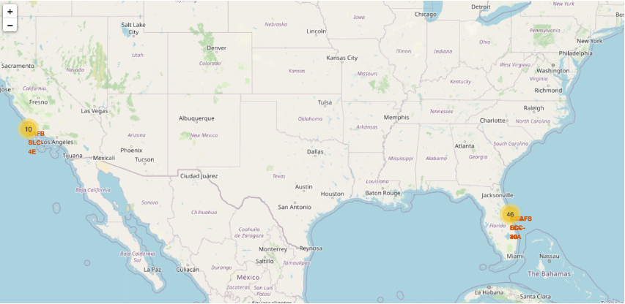
Results
Interactive maps make it easier to identify launch sites and its surrounding

Slide 18
Results
The predictive analysis shows that Decision Tree is the best model with an accuracy of 89.11%

Slide 19

Section 2

Slide 20
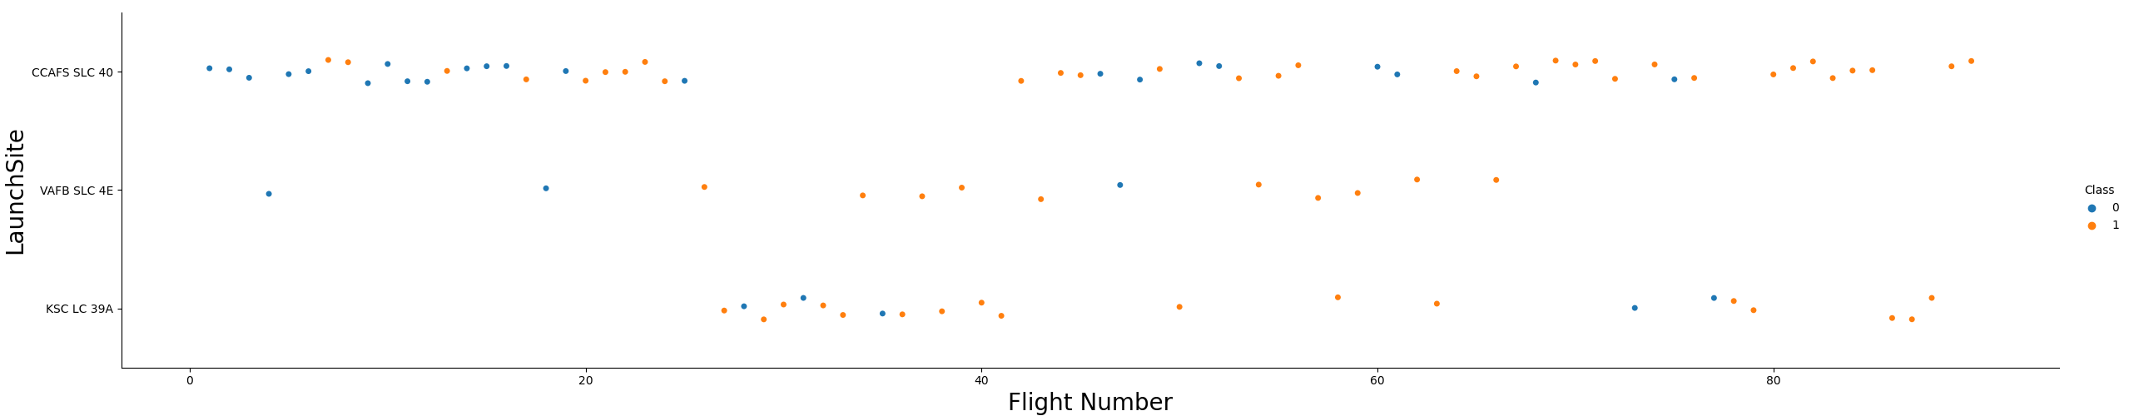
Flight Number vs. Launch Site
According to the plot, CCAFS SLC 40 has most recent successful launch
The success rate increases over time

Slide 21
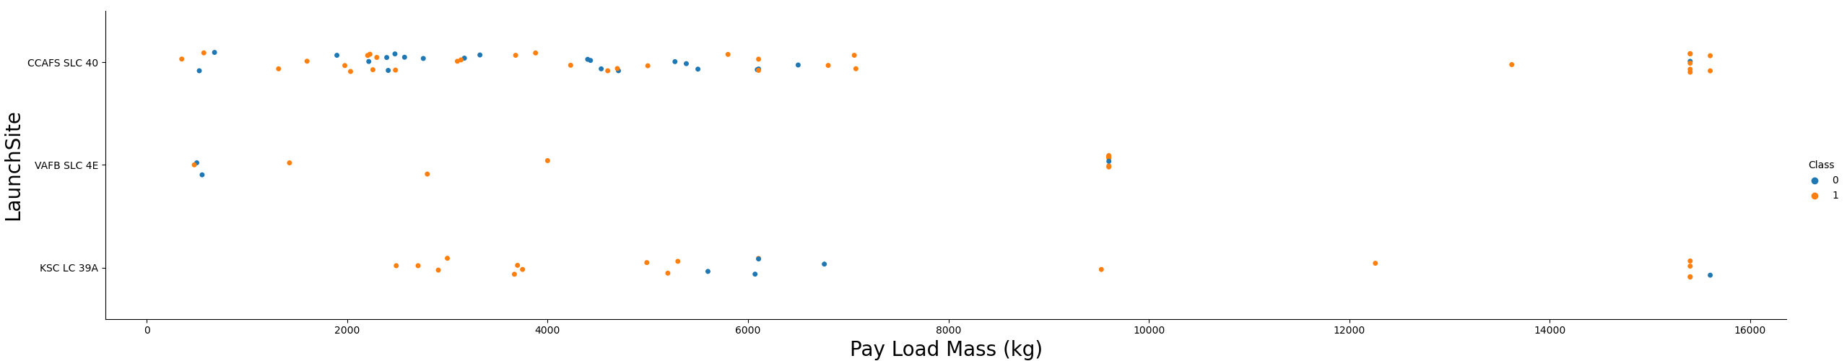
Payload vs. Launch Site
Higher payloads have higher success rates and according to the plot, only two launch sites are capable of payload over 12000 kg

Slide 22
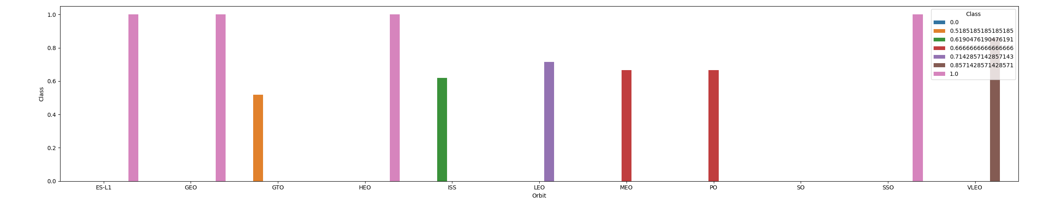
Success Rate vs. Orbit Type
ES-L1, GEO, HEO, and SSO shows the highest success rate

Slide 23
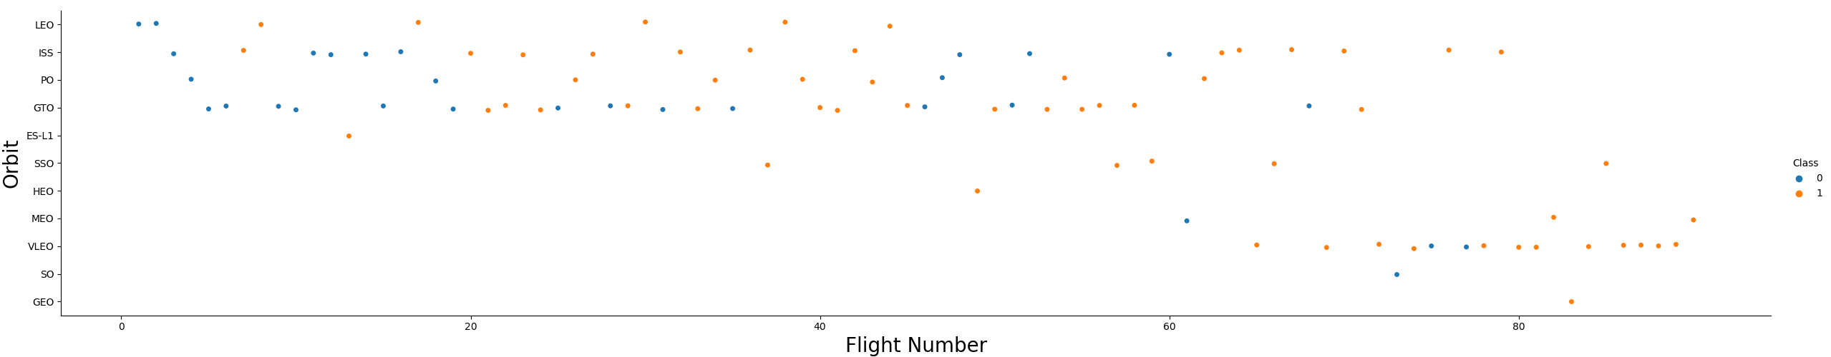
Flight Number vs. Orbit Type
Success rate to all orbit increases over time

Slide 24
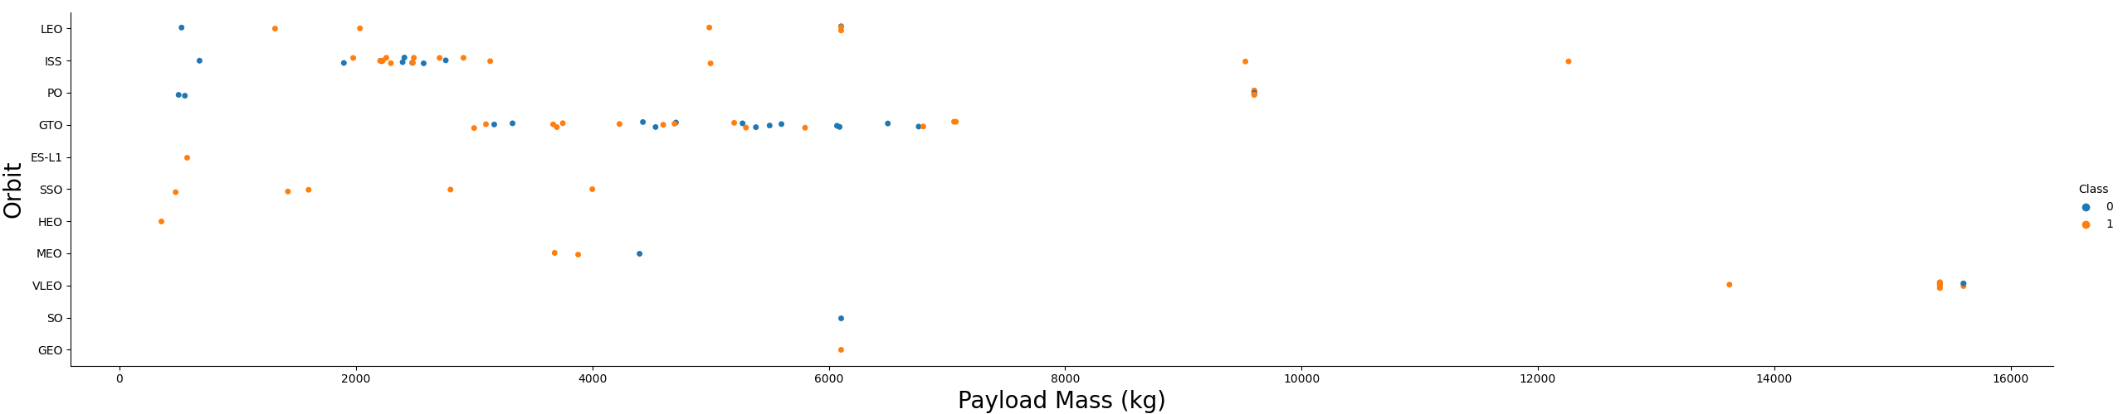
Payload vs. Orbit Type
Payload and success rate not correlated for GTO
ISS has better success rate with a wider range
Few launches for SO and GEO

Slide 25
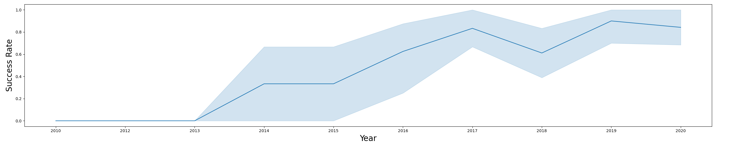
Launch Success Yearly Trend
Generally, the launch success is increasing over the year with flops during 2017-2018 and 2019-2020

Slide 26
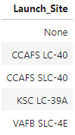
All Launch Site Names
There are four launch sites obtained by unique function in launch_site

Slide 27
Launch Site Names Begin with 'CCA'
The record shows launch sites begin with ‘CCA’
Date | Time (UTC) | Booster_Version | Launch_Site | Payload | PAYLOAD_MASS__KG_ | Orbit | Customer | Mission_Outcome | Landing_Outcome
06/04/2010 | 18:45:00 | F9 v1.0 B0003 | CCAFS LC-40 | Dragon Spacecraft Qualification Unit | 0.0 | LEO | SpaceX | Success | Failure (parachute)
12/08/2010 | 15:43:00 | F9 v1.0 B0004 | CCAFS LC-40 | Dragon demo flight C1, two CubeSats, barrel of Brouere cheese | 0.0 | LEO (ISS) | NASA (COTS) NRO | Success | Failure (parachute)
22/05/2012 | 7:44:00 | F9 v1.0 B0005 | CCAFS LC-40 | Dragon demo flight C2 | 525.0 | LEO (ISS) | NASA (COTS) | Success | No attempt
10/08/2012 | 0:35:00 | F9 v1.0 B0006 | CCAFS LC-40 | SpaceX CRS-1 | 500.0 | LEO (ISS) | NASA (CRS) | Success | No attempt
03/01/2013 | 15:10:00 | F9 v1.0 B0007 | CCAFS LC-40 | SpaceX CRS-2 | 677.0 | LEO (ISS) | NASA (CRS) | Success | No attempt

Slide 28
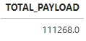
Total Payload Mass
The total payload was calculated using sum function from the payload_mass_kg_

Slide 29
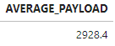
Average Payload Mass by F9 v1.1
The average payload mass by F9 v1.1 was calculated using avg function on payload_mass_kg_

Slide 30
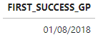
First Successful Ground Landing Date
The first successful landing date is determined using min function on date

Slide 31
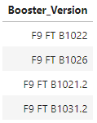
Successful Drone Ship Landing with Payload between 4000 and 6000
List of the names of boosters which have successfully landed on drone ship and had payload mass greater than 4000 but less than 6000. These obtained by using distinct function on booster_version

Slide 32
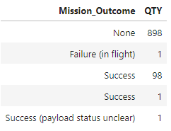
Total Number of Successful and Failure Mission Outcomes
The total number of successful and failure mission outcomes calculated count function after grouping the mission_outcomes

Slide 33
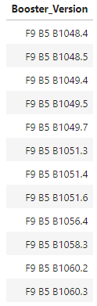
Boosters Carried Maximum Payload
List of the names of the booster which have carried the maximum payload mass. These obtained by using distinct function after filtering the maximum payload

Slide 34
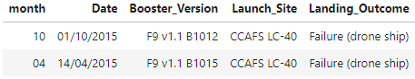
2015 Launch Records
List of the failed landing outcomes in drone ship, their booster versions, and launch site names for in year 2015. There are only two failure.

Slide 35
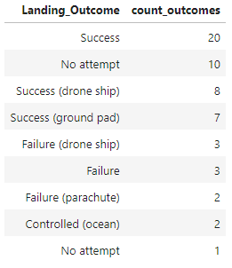
Rank Landing Outcomes Between 2010-06-04 and 2017-03-20
Rank of landing outcomes (such as Failure (drone ship) or Success (ground pad)) between the date 2010-06-04 and 2017-03-20. The data included no attempt

Slide 36

Section 3

Slide 37
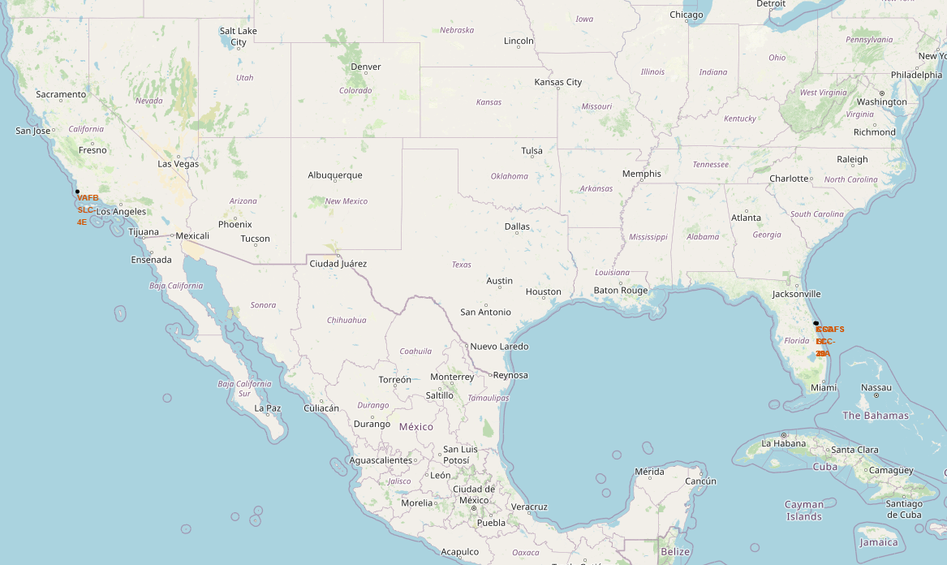
Launch Sites Location
Every launch site build near railroad as access point and near sea.

Slide 38
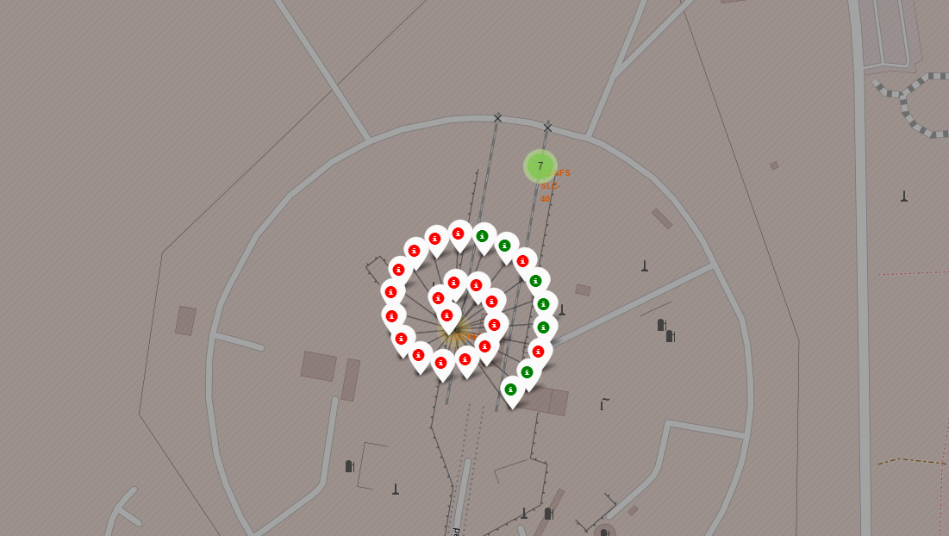
Launch Outcomes
Launch outcomes are displayed with green as success and red as failure.

Slide 39
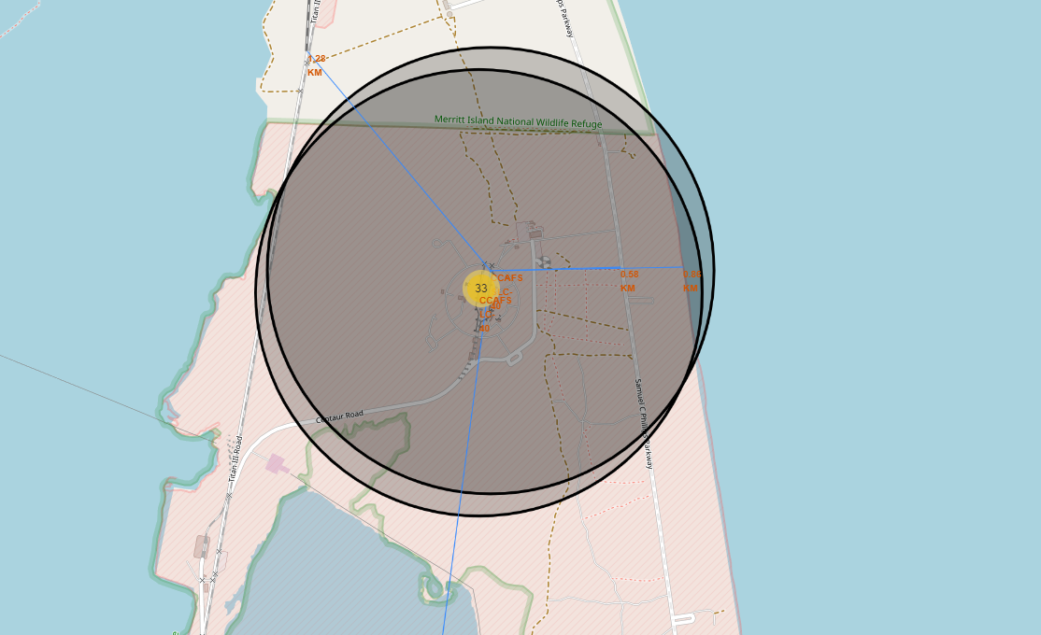
Access Point to Launch Sites
The launch site are connected with railroads from many location which mean the site is very accessible

Slide 40

Section 4

Slide 41
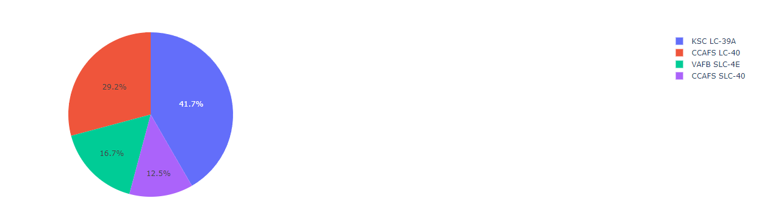
Successful Launch Sites
Pie chart showing where the most successful launch site

Slide 42
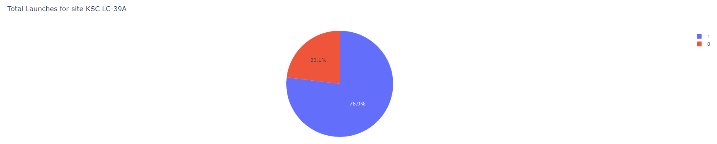
Highest Success Rate Launch Site
KSC LC-39A is the most successful launch site with a success rate of 76.9%

Slide 43
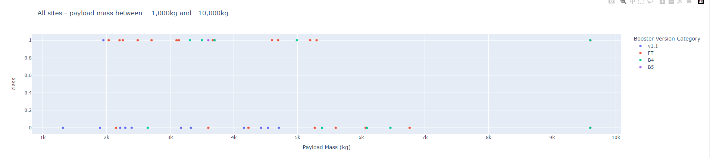
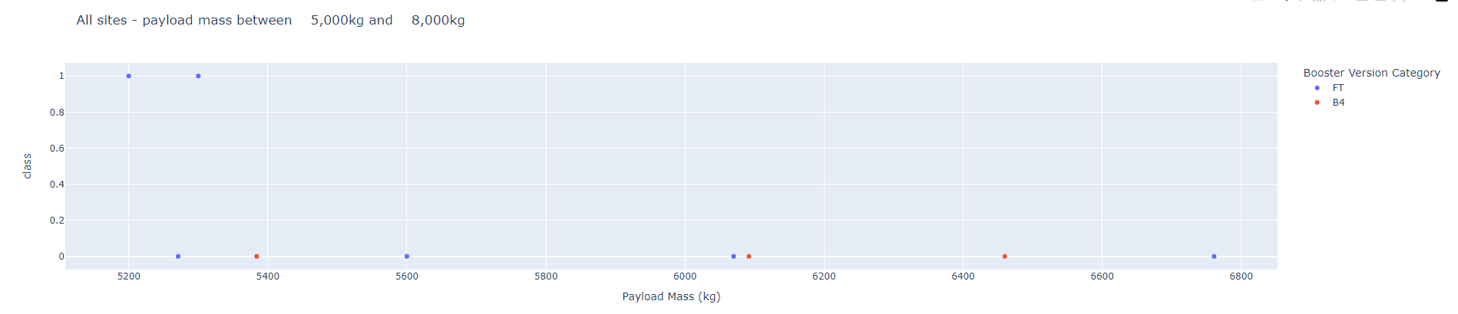
<Dashboard Screenshot 3>
Different payloads have different outcomes. Payload with in the range 2,000-6,000 has the most success rate while in the range of 5,000-8,000 have fewer data to calculate.

Slide 44

Section 5

Slide 45
Classification Accuracy
Decision Tree is the best model with the highest accuracy out of four different model
Decision Tree has an accuracy of 89.11% and a test of 72.22%

Slide 46
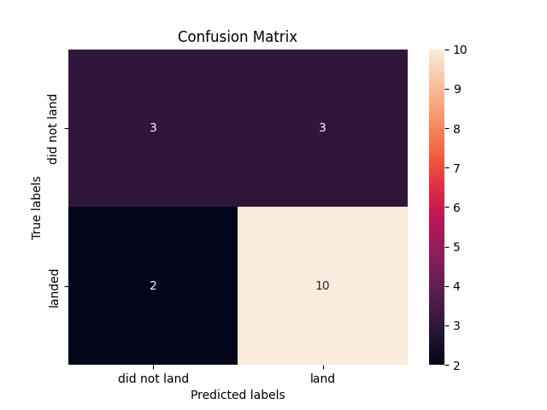
Confusion Matrix
The confusion matrix shows that Decision Tree has a high number of true positive and true negative

Slide 47
Conclusions
Two datasets were analyzed and the result was interpreted
KSC LC-39A is the launch site with the highest success rate
Launch under 6,000 kg has a high success rate yet a high failure rate
Success rate increased over time
Decision Tree classifier is the best model to used made prediction of the landing outcome

Slide 48
Appendix

Slide 49


